Slide 1

Trends in Data Science
Kaggle survey 2017-2021

Slide 2
Analysis
Methodology
The analysis will focus on trending technologies, thus only multi-part questions are included.
PCA is performed on one-hot encoded data to find principal axes of maximum variation
Interpretation
Trends uncovered in this report represent largest changes in technology usage trends.
It is meant to give a sense of where tech trends are headed towards.

Slide 3
Tech Usage Trends
Python EDA Tools
Desire to learn GCP/AWS/Azure and other enterprise tools
Deep learning usage
Data science interest on blogs and YouTube
IDE: VSCode usage
R usage
Data science online learning

Slide 4
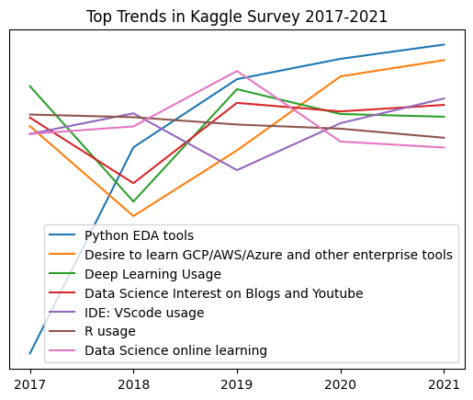
Top trends
1. Usage of Python EDA and ML tools like matplotlib and scikit-learn have risen sharply since 2017 and have continued to increase steadily.
2. Interest in cloud technologies fluctuate a lot but has been increasing since 2018.

Slide 5
Top trends
3. Deep learning usage fluctuates a lot around the same level over time.
4. Data science interest on social media platforms seems to move with deep learning usage.
5. VSCode usage is steadily increasing since 2019

Slide 6
Top trends
6. R Usage has been declining slowly but steadily since 2017
7. Data Science Online learning peaked in 2019 but seems to be in a gradual decline

Slide 7
Implications
- Usage of python tools like matplotlib and scikit-learn have grown very fast over the years and should be part of any data science curriculum.
- Cloud and enterprise technologies have had a resurgence of interest since 2018. Practitioners should pay attention to them as indispensable components of their data science toolkit.
- There is a surge of usage in deep learning from 2018 to 2019. Usage has stabilized since then. Companies should assess whether deep learning tools are relevant to their businesses, if they have not done so.

